Slide 1
Google Machine Learning

Slide 2
Introduction to Machine Learning
https://developers.google.com/machine-learning/intro-to-ml

Slide 3
Introduction to Machine Learning
Model
  Set of parameters and structure need to make predictions
  Example:
    Supervised Learning
      Input is an example
        The values of rows ( observation ) and possibly a label
  A feature can be a
    Input feature
    synthetic features ( derived from input features )
    feature cross ( combination of categorical features )
  Can continuously evolve making better and better predictions

Slide 4
Introduction to Machine Learning
Type of ML Systems
  Supervised learning
    regression model – Given a set of features predicts a numeric value
    classification – Predicts something belongs to a category.
      Binary
      Multi-class Classification
  Unsupervised Learning
    Provide with data that does not contain any correct answers
    The model will identify meaningful pattern among the data
      Must infer the rules
  Reinforcement Learning
    Makes predictions by getting rewards or penalties based on action performed
    Generates a policy : In reinforcement learning, an agent's probabilistic mapping from states to actions which defines the best strategy for getting the most rewards
    Example : Alpha Go

Slide 5
Introduction to Machine Learning
  Generative Learning
    class of models that crates content from user input
    Ex, images, music and jokes, summarization
    Input can be imagees, audio and video
    Different type of models input-output
      text-to-text
      text-to-image
      text-to-video
      text-to-speech
      text-to-code
      text-to-speech
    Production
      Generative models are nitially trained using an unsupervised approach where the model learns to mimic the data its trained on
      Sometimes trained further using supervised or reinforcement learning on specific data relate to task the model might be performed.
  Transfer Learning

Slide 6
Introduction to Machine Learning
Supervised machine learning is based on the following concepts
  Data
    Observation which contain features and a label
    model predicts label from the features
    Characteristics of a dataset
      size Number of Examples
      diversity Range example covert
      Good Datasets are large and diverse
      The Greater the number of features can discover additional patterns, but don’t always produce models that make better predictions because some features might have no causal relationship to the labels
  Model
    A complex set of numbers that define the mathematical relationship from specific input feature patterns to specific output label values
    discovery the values through training

Slide 7
Introduction to Machine Learning
  training
    The model finds the best solution by comparing its predicted value to the labels actual value
      loss = predicted - actual value
    The solution is gradually updated
    Learns the mathematical relationship between the features and the label so it can make the best predictions on unseen data
    Models gradually learn the correct relationship between the features and the label
      The gradual understanding is why large and diverse data is needed
        Helps to refine its understanding of the relationship between the feature and the label
  Evaluating
    Used to determine how ell it learned
    Provide the features and compare the prediction to the labels true values
  Prediction are the same as inferences

Slide 8
Machine Learning Crash Course
https://developers.google.com/machine-learning/crash-course/descending-into-ml/video-lecture

Slide 9
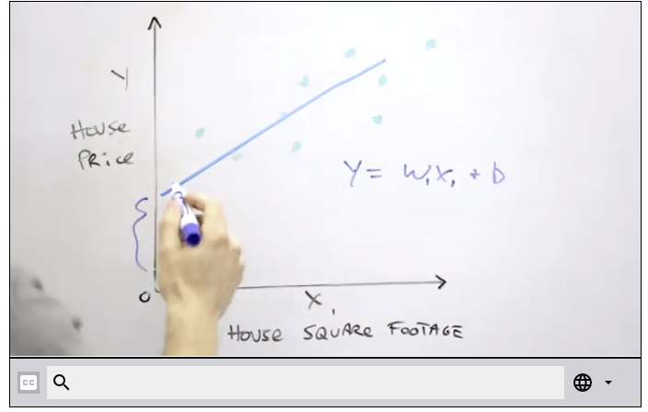

Machine Learning Crash Course
Introduction
  Check the reliability of your datset
    Ex. most users do not mark every suspicious email as spam
Descending into ML
  Linear Regression
  L2 Loss also called square error
    ( observation - prediction )² or (y - y’ )²
  As we get further away from the true value the loss becomes greater

